Slide 1
Image Recognition: Indoor/Outdoor Setting
David Cimino, Tohibur Paiker, Yamin Alam

Slide 2
Motivations
The widespread adoption of mobile devices has created the need for “context” aware applications
Robotic navigation and navigation applications often need to know whether the current location is indoor or outdoor
Notes:
-Context being the variety of aspects surrounding a mobile device user like geo-location, time, environment, temperature, etc.
-these navigation apps need to know this in order to determine what location mechanisms to use—GPS is useful for outdoor environments while other phone sensors and wifi-networks are more useful for indoor environments

Slide 3
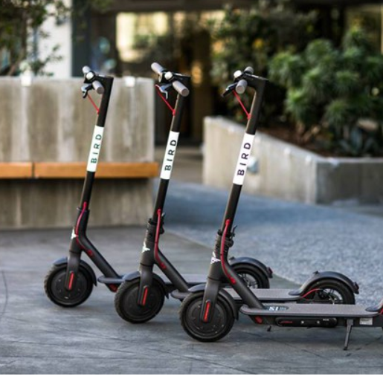
Real World Practical Applications
Electronic Scooter Apps
Mobile Cameras
Notes:
-Electronic Scooter Apps face the problem of making sure people leave them outside rather than stock them up in their house. When docking an electronic scooter after use, the apps usually require you to take a picture of where you leave them. Wanting them to be publicly available, the apps photo mechanism would want to make sure the environment for the photo is outdoors
-Indoor photos are often personal and tend to not require the user to capture a wide area. Contrast this with outdoor photos where one would usually like to capture a landscape or tall structure. If the phone can automatically sense whether you are indoor or outdoor, it can adjust the zoom of the camera accordingly

Slide 4

LARGE DATASET REQUIRED!
Image Recognition Machine Learning models tend to require large datasets
Flickr provides an easy option to download many images
Also allows us to classify images for modeling purposes

Slide 5




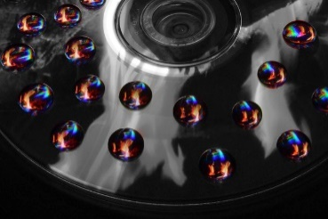



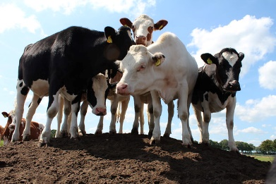
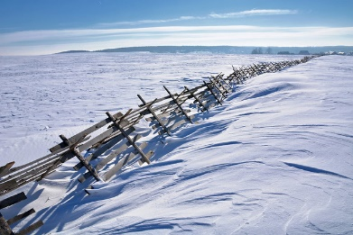
Data
Training Set: 1400 Images
Test Set: 600 Images
Each set split in half between indoor images and outdoor images
Used a neural network classifier model (sequential)

Slide 6
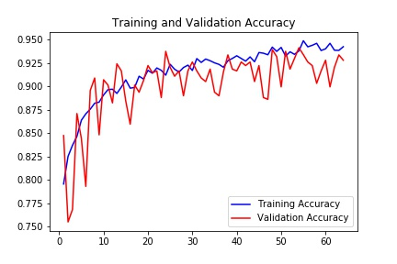
Training and Validation Accuracy
Looks pretty good!

Slide 7
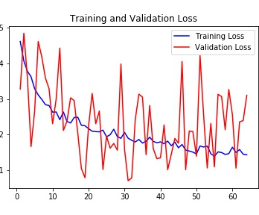
Training and Validation Loss
Yikes!

Slide 8
Accuracy on Testing Set
79.3%

Slide 9
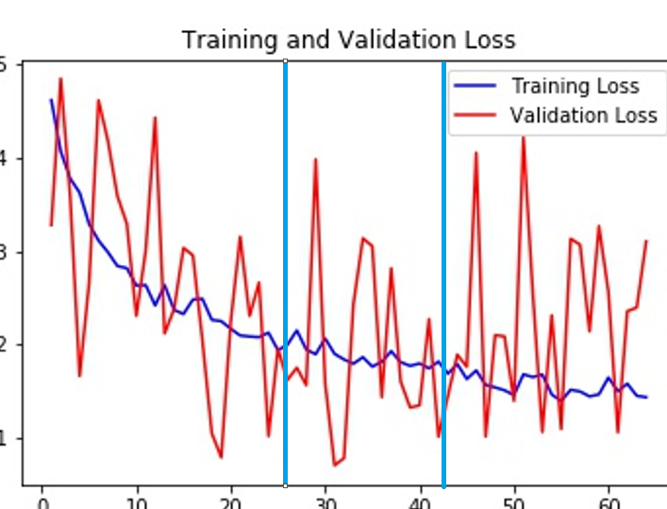
What’s Going On?
Overfitting: hyper-finetuned to the training set, but will not be as good for predicting outside of that
Solutions:
stopping the training process earlier
removing features
using more data

Slide 10
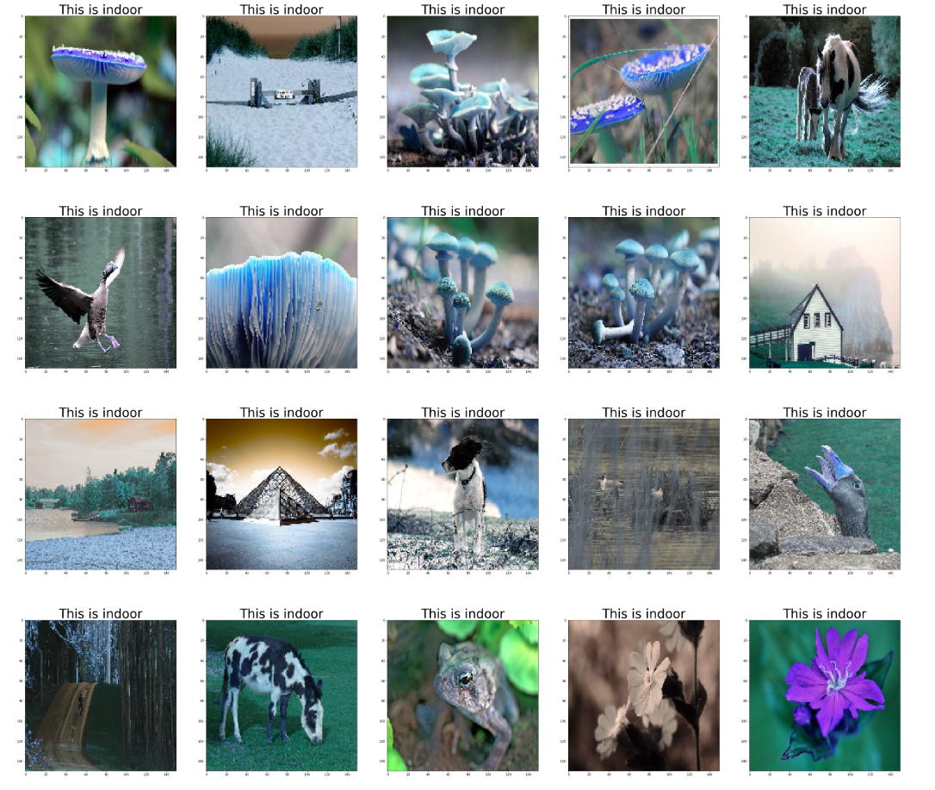
Taking a Deeper Look Into the Errors

